Slide 1
Turkey Turmoil

Slide 2
Scenario
Freedom Turkey and Liberty Turkey were going about their daily routines one day when their worlds were flipped and turned upside down! The turkeys woke up from afternoon naps unsure of what happened, where they were, but most importantly, the turkeys didn’t recognize themselves! “WHO am I?” questioned Freedom Turkey, most alarmed. “WHO do you think I am?” wondered Liberty Turkey.
One of the turkeys is a wild turkey and one is a farm or domestic turkey. But which is which?!?
Meanwhile, the sneaky coyote, watched from behind a tree as the confused turkeys wandered around, questioning who they were and where they’re from. The coyote is a prime suspect. We think he stole their identities and memory and after, left them in the middle of nowhere! Now it’s up to US to return each turkey to where they belong by reminding them of their instincts, characteristics, diet and habitat!

Slide 3
Habitat
The habitat group has an important job, we must help the turkeys understand where they live. Read about various turkey habitats and browse the photo library to help Freedom turkey and Liberty turkey find an easy route back to the correct home!

Slide 4
Farm Turkeys
Another name for a farm turkey is a “domestic” turkey. Turkey farmers work hard to keep their birds healthy and comfortable by raising them in barns. Turkey barns are warm and dry in the winter and cool from big fans blowing in the barn during the summertime. Scientists, engineers and farmers have worked hard to design and build turkey barns to provide the best place for turkeys to live. Turkey flocks living in barns are protected from predators, disease and bad weather. Imagine one and a half football fields together, that’s about the size of a turkey barn. About 10,000 turkeys make up a flock living in a turkey barn. In a turkey barn, there is food and water available for turkeys at all times. Turkey barns have automatic feeders and waterers to give turkeys feed or water whenever they want. Imagine living at a buffet restaurant with all of your friends and family. That’s what it’s like for turkeys living in a barn, eating and drinking whenever they want. Turkey farmers care for their turkeys. During their chores, farmers check on their turkeys at least twice a day to make sure feeders, waterers and fans are working well. The farmers watch over and listen to their turkeys to make sure the animals are healthy and comfortable.

Slide 5
Wild Turkeys
Wild turkeys live outside in forests, woodlands and grasslands where they can roost in trees and find their food on the forest floor and in tall grasses. Wild turkeys are safe from most predators when they nest in the trees above the ground. Wild turkeys live in flocks ranging from 5-50 turkeys. For most of the year, the hen (female turkey) and her poults (young turkeys) live together in a family flock. An adult male turkey is called a Tom and will live in a flock with other toms and hens.

Slide 6
Evidence
Where do Freedom and Liberty belong? Is Freedom or Liberty a farm or wild turkey? Use your research about where turkeys live, to help the class decide what kind of turkeys we are working with!

Slide 11
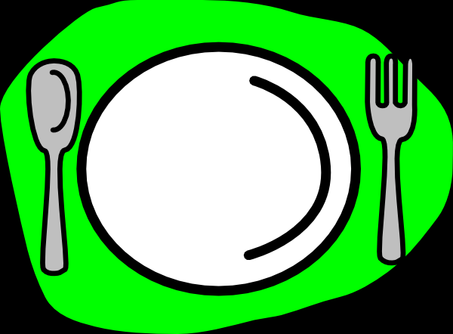
Turkey Diet
Helping Freedom Turkey and Liberty Turkey remember their favorite meal to eat will help us return them to their proper homes!
Which feed items would farm turkeys prefer?
What do wild turkeys like to eat?
Your decision will help tell us where the turkey lives, based on what they eat!

Slide 12
Farm Turkeys
Turkeys need food and water, just like humans do. The food turkeys eat is called feed and is made up of ground corn, soybeans and a mix of vitamins and minerals. Turkey farmers feed their turkeys with automated feeders. The feed travels through long pipes and tubes in the barn to the automatic feeder, giving turkeys access to feed whenever they want. Farmers, nutritionists and the feed mill work together to make the best feed for the turkeys.

Slide 13
Wild Turkeys
Wild turkeys search the forest floor and grassland for nuts, seeds, grains, fruits, berries and insects to eat. When wild turkeys are feeding and searching for their food, it’s called foraging. Wild turkeys forage for food in the early morning after sunrise and for a few hours before sunset.

Slide 14
Evidence
If we remind Freedom and Liberty what they like to eat, they will be closer to remembering their identity!
Now that you have learned a little more about what farm turkeys eat versus wild turkeys, which of our turkeys likes to eat in a barn and which gets their food from the wild?

Slide 15
Turkey Characteristics
What are major characteristics of turkeys?
What are some special features or qualities for a farm turkey?
How about a wild turkey, what do they look like?
Use the information provided in this file to find out!

Slide 16
Farm Turkeys
The most popular farm turkey breed is called a “Broad Breasted White” which means it is a white feathered turkey that produces a lot of breast meat, which consumers love! Turkeys grow white feathers, have blue heads, a red wattle under their beak and a red snood on top of their beak. Most farm turkeys have white feathers because dark feathers leave marks on the skin of the turkey. A fully grown farm turkey can weigh 45 pounds, that means they are producing lots of meat for consumers!

Slide 17
Wild Turkeys
Wild turkeys are a large bird with dark feathers. Their long, thin legs help them run fast and fly short distances up to 55 miles per hour. Their dark feathers and fast legs are very important! These features help them blend into the forest and grasslands as camouflage, and their speed helps them fly to perch in trees. This helps protect them from predators. Wild turkeys weigh less than farm turkeys, this makes it possible for them to run fast and fly in the air for short distances. A wild turkey will range from 5-20 pounds.

Slide 18
Evidence
Who protects the farm turkeys?
How do wild turkeys keep themselves safe?
Besides the sneaky coyote who stole their identity, what other wild animals are predators to turkeys?

Slide 19
Compare
Farm Turkeys
Wild Turkeys
Farm turkeys have shorter legs and don’t run very fast, so their tracks are close together.
Wild turkeys have long legs and can run very fast, so their tracks are farther apart.

Slide 20
Turkey Instincts
Since our turkeys do not remember much about themselves, we need to remind them of what they like to do each day.
What are some of the things in your daily routine?
How important are your instincts or daily routine?
Let’s help our turkey friends get back on track! Think of what a domestic farm turkey does each day.
What are wild turkeys great at?

Slide 21
Farm Turkeys
Domestic turkeys are social and noisy birds who live with their flock in a barn, being taken care of by farmers. Their daily routine is to keep comfortable, eat food and drink water whenever they want. A farm turkey has an important job, each day they grow bigger to one day become an important food product. Farm turkeys spend their time eating and hanging out in their barn. They are safe from bad weather, predators and disease when living in a barn.

Slide 22
Wild Turkeys
Wild turkeys spend all their time in the great outdoors! When wild turkeys are feeding and searching for their food, it’s called foraging. They forage in the early mornings at sunrise or right before the sun sets at night. Wild turkeys have great eyesight which helps them see the landscape and watch out for predators. At night, they fly into the trees to “roost”, or hang out, above ground where predators cannot reach them. Their long, thin legs help them run fast, wild turkeys can run as fast at 25 miles per hour and fly up to 55 miles per hour! A turkey living in the wild uses their big, strong wings to fly short distances. They can fly as far as one mile at one time. These turkeys communicate too, but are much quieter! Wild turkeys have over 30 different calls they can make to communicate with each other. Wild turkeys stay busy foraging for food, roosting in trees and traveling fast when they need to. Wild turkeys also have camouflaged feathers to help them blend into their environment and stay safe from predators.

Slide 23
Evidence
Why is it important for a wild turkey to fly or have brown and black feathers?
Why are farm turkeys bigger than wild turkeys?
Who protects the farm turkeys from predators and bad weather?

Slide 24
Thank You
More Resources:
Lessons
Links
Contact

